Slide 1


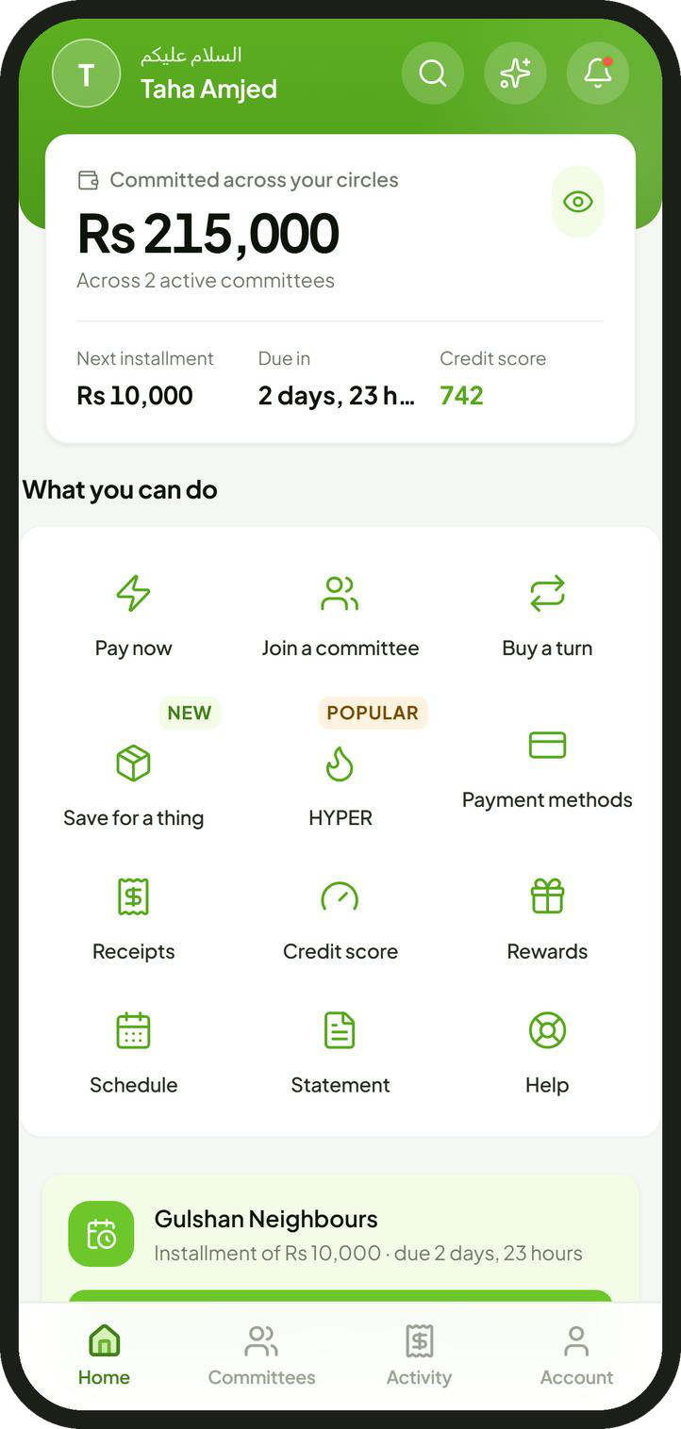
Committee savings, held and moved by a bank
A partnership proposal for Mashreq Bank Pakistan
Taha Amjed, Chairman, Halqa
October 2026
Notes:
Halqa runs committees, the rotating savings groups most Pakistani families already use. This proposal asks Mashreq to hold and move every rupee, while Halqa runs the committee itself.

Slide 2
Summary
Halqa proposes to run Pakistan's committees on Mashreq accounts.
The habit
More than a third of Pakistanis save in committees, in cash, outside any bank.
The proposal
Every member banks with Mashreq. Mashreq holds and moves every rupee; Halqa runs the committee.
For Mashreq
Accounts opened 6 to 20 at a time, deposits, an Islamic product and a repayment record to lend against.
For members
No organiser holding cash, automatic payment, cover against default and a credit record.
The request
Seven decisions, then one live month with about 1,000 members.
2
Notes:
Five points carry the proposal. The habit exists and moves in cash. Every member banks with Mashreq and Mashreq moves all the money; Halqa provides the rules and the technology. Mashreq gains accounts, deposits and a lending record; members gain safety and a credit history. The request is seven decisions and a one month pilot of about 1,000 members.

Slide 3
How a Committee Works
Everyone pays the same amount each month. Each month, one member takes the whole pot.
Month
Rs 10,000
1
2
3
4
5
6
7
8
9
10
11
12
1
2
paid in by every member, every month
3
Rs 120,000
4
5
the pot, taken by one member each month
6
Member
7
8
First turn. An advance without interest, repaid by the instalments that follow.
Last turn. Saving, with a deadline the group enforces.
9
10
11
In total, every member pays in Rs 120,000 and takes out Rs 120,000. No interest.
12
collects the pot
pays Rs 10,000
Also called a kameti or BC; worldwide, a rotating savings and credit association. Example: twelve members at Rs 10,000 a month.
3
Notes:
Twelve members each pay Rs 10,000 a month. Each month one of them takes the pot of Rs 120,000. The first member receives an advance without interest; the last member saves with discipline. Over twelve months everyone pays in exactly what they take out, which is why a committee carries no interest.

Slide 4
The Market
More than a third of Pakistanis save in committees. Almost none of that money reaches a bank.
Where Pakistani savers keep their savings, per cent of savers [2]
34% to 41%
Cash kept at home
63%
of Pakistanis take part in committees [1]
Rs 4 trillion
A committee
33%
estimated to pass through committees each year [1]
A bank or other formal institution
4%
Twice
the rate of participation for women as for men [2]
Sources 1 Karandaaz and Oraan, reported by Dawn, 12 December 2022 2 Financial Inclusion Insights surveys of Pakistan
4
Notes:
Participation estimates range from 34 per cent (Karandaaz) to 41 per cent (Oraan) of Pakistanis, with about Rs 4 trillion estimated to rotate each year. Among savers, 63 per cent keep cash at home, 33 per cent use a committee and only 4 per cent use a bank or other formal institution. Women take part at twice the rate of men.

Slide 5
The Problem
Committees run on trust and cash. When the trust fails, members lose their money.
12%
Can disappear with the pot
May stop paying after collecting
of committee users lost money to fraud [1]
Members
Organiser
Collector
Rs 420 million
cash
cash
each pays Rs 10,000 in cash or by transfer
holds everyone's money
this month's turn
taken from 117 committees by one organiser, 2022 [2]
Savings otherwise kept as cash at home
63%
A notebook
the only record
of savers keep savings as cash at home [1]
No record a lender can read
Sources 1 Financial Inclusion Insights surveys of Pakistan 2 Dawn, 12 December 2022
5
Notes:
In the informal committee one person holds everyone's money and the record is a notebook. Twelve per cent of committee users report losing money to fraud; in 2022 one organiser took about Rs 420 million from 117 committees. The member who collects early may stop paying, and years of paying on time build no credit record.

Slide 6
The Proposal
Halqa is the system. Mashreq is the machine. Every rupee stays inside Mashreq.
money
Halqa
Halqa runs
instructions
rules, turns, checks, records
Hosts, members, circles and the order of turns
Checks on identity, income and affordability
Reminders, late payments and recovery
The ledger, receipts and records
instructions
confirmations
Inside Mashreq Bank Pakistan
Mashreq runs
Members' accounts
Circle account
Collector's account
Accounts and customer checks
Direct debits and payouts
Savings and profit on balances
Cover and credit reporting
Rs 10,000 debited from each
the pot gathers on the due date
Rs 120,000, the same day
Halqa never holds member money and never lends.
6
Notes:
The money never leaves Mashreq. Each instalment is debited from the member's own Mashreq account into the circle's account, and the pot goes to the collector's Mashreq account the same day. Halqa sends the instructions and keeps the records; Mashreq executes and confirms each step. Halqa's own account receives only its agreed share of income.

Slide 7
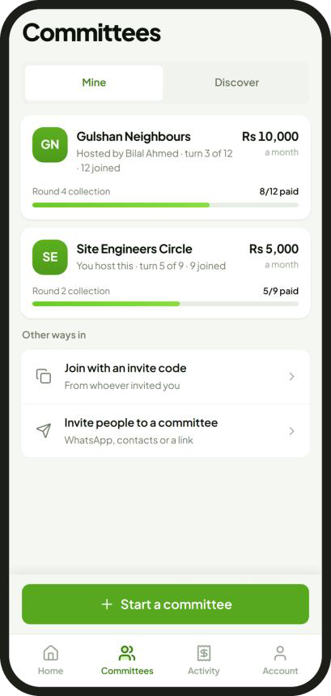
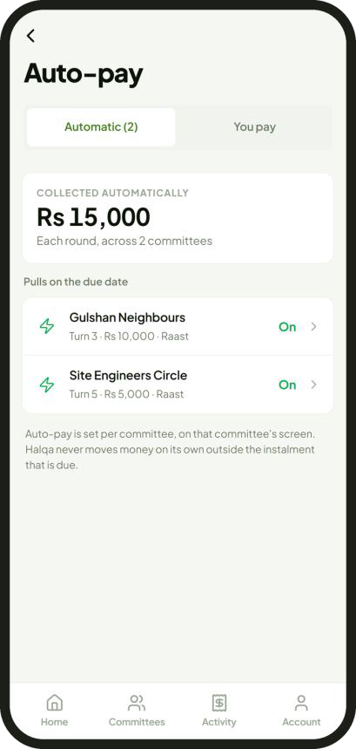
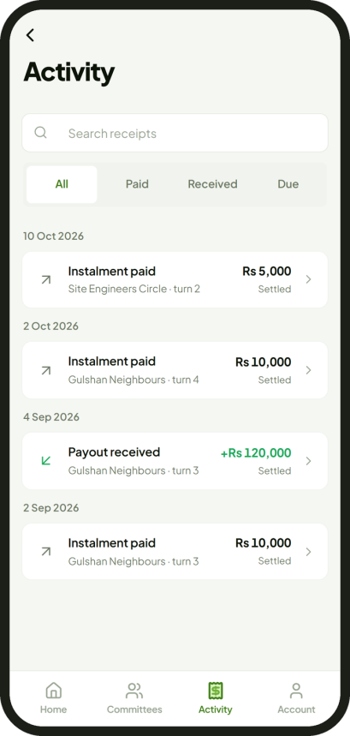
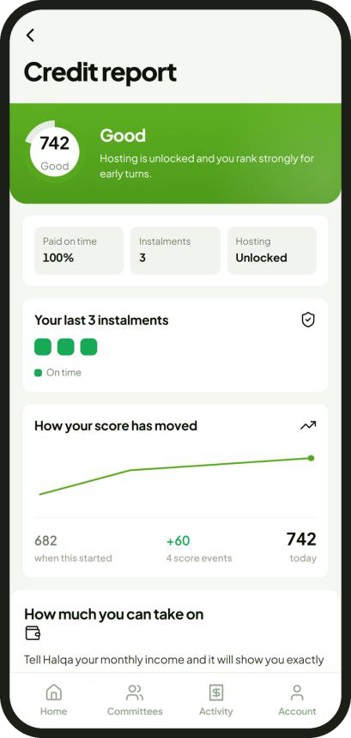
The Product
Members do everything in the Halqa application. Under the partnership, the Mashreq account opens inside it.
1 Join a circle
2 Pay automatically
3 Collect the pot
4 Build a credit record
Only circles and turns the member qualifies for
Debited by Mashreq on the due date
Paid into the member's own account
Every payment scored and reported
Screens from the Halqa application in preview, with sample data.
7
Notes:
One application for the member: join a circle and pick a turn the member qualifies for, authorise the debit once, receive the pot in the member's own account, and build a credit record from every payment. Under the partnership, Mashreq's account opening screens run inside the application. The screens shown are the current preview with sample data.

Slide 8
A Month Inside Mashreq
Each step runs on a Mashreq product. The debit mandate is the one new piece.
Due date, the 8th
instalment waiting and earning profit
retries
day
1
5
8
10
15
20
25
30
Payday
Waiting
Due date
Missed debit
Circle ends
Salary arrives in the member's Mashreq account.
The instalment earns profit for about seven days.
Every member is debited; the pot is paid the same day.
One retry each morning, five at most.
Profit returns to members as points.
NEO current account
Islamic Current Profit Account, up to 5%
Debit mandate, new; free instant transfer
Islamic Savings Account, up to 11.5%
Also used. The Mashreq Pakistan Account, for families in the UAE. New lines. Cover for defaults; financing for asset circles.
Mashreq NEO product pages and rate sheets, read 29 September 2026; rates are up to figures. The due date of the 8th is proposed.
8
Notes:
Salary arrives, the instalment waits about seven days in the Islamic Current Profit Account and earns profit, and Mashreq debits it on the due date and pays the pot the same day. A failed debit is retried each morning for up to five days before late fees apply. When the circle ends, the profit returns to members as points. The debit mandate is the one new product Mashreq would add. The due date of the 8th is proposed.

Slide 9
Mutual Benefit
100,000 members would add about Rs 2.5 billion of deposits and 100,000 accounts.
Customer deposits, Rs billion
Mashreq's aim or need
What committee members bring
25
10 million customers in five years
Accounts opened 6 to 20 at a time
Salaried people and women
Women join at twice the rate of men
8.5
Islamic first banking
No interest; one flat fee; takaful
2.5
A lending book; no advances yet
A repayment record for every member
0.25
Mashreq
30 June 2026
10,000
members
100,000
members
1,000,000
members
Overseas Pakistanis
UAE families in the same circle
Assumes Rs 25,000 average balance a member. Mashreq's own figures replace this.
Sources Mashreq Bank Pakistan, half year accounts to 30 June 2026: deposits Rs 8,515 million, no advances; Mashreq press release, 24 November 2025
9
Notes:
On stated assumptions, 100,000 members bring about Rs 2.5 billion of deposits, against Rs 8.5 billion Mashreq held at 30 June 2026. The assumption is an average balance of Rs 25,000 a member once salaries move to Mashreq; Mashreq's own data should replace it. Each circle opens 6 to 20 accounts at once, and the repayment records give Mashreq a base to start lending.

Slide 10
Onboarding and Checks
Mashreq checks the customer. Halqa checks whether the member can carry the committee.
Member
Sign up
Sees only the circles and turns open to this member
phone number, one time code, PIN
Mashreq
Account
CNIC, NADRA biometric check, due diligence, debit mandate
Halqa
Identity
Income
Affordability
Credit score
CNIC and account names match; live face check
salary or daily income arrives regularly
all instalments within a third of income
300 to 850; decides which turns open
Checks rise with risk. Known circles: identity only. Strangers: income, affordability and a credit report as well. Hyper: proof of daily income too.
Stored. Results only; never face images, card numbers or passwords.
10
Notes:
Mashreq opens the account with its own checks: CNIC, NADRA biometric and due diligence, and the member authorises the debit mandate. Halqa then checks identity, income and affordability and computes a credit score from 300 to 850. The member sees only the circles and turns open to them. Halqa stores results only.

Slide 11
Committee Types
The less members know each other, the more checks apply.
Known
Strangers
Large, strangers
Asset
UAE family
Hyper
Who
family, colleagues, neighbours
matched by Halqa
traders and larger savers
buying a motorcycle or machine
families in the UAE and Pakistan
daily earners: drivers, riders, traders
Members
6 to 12
12
20
12
6 to 12
390 to 400
Instalment
Rs 2,000 to 10,000
Rs 10,000
Rs 25,000
Rs 10,000
any amount
Rs 450 to 500 a day
Frequency
monthly or weekly
monthly
monthly
monthly
monthly
daily
Income checked
Automatic debit
Cover
Credit report read
Stage
pilot
after the pilot
after the pilot
after the pilot
after the pilot
experimental
required
not required
Turn bands apply in every type. Cover and financing follow the bank's choice of product.
11
Notes:
Known circles are family, colleagues or neighbours; the group knows its members, so checks are light and there is no cover. Circles of strangers, large circles and asset circles carry full checks, automatic debit and cover. UAE family circles join relatives abroad through Mashreq's non resident accounts. Hyper is a daily circle for daily earners, labelled experimental. The pilot uses known circles only.

Slide 12
Where the Risk Sits
Only an early collector can leave others short. Early turns need strong credit scores.
Still owed after collecting, by turn, Rs thousand: twelve members at Rs 10,000
Turn bands. The credit score decides which turns a member may claim.
110
100
90
80
70
New members. The last three turns only, until two clean circles.
60
50
40
30
Affordability. All instalments within a third of verified income; 40% with other loans.
20
10
0
1
2
3
4
5
6
7
8
9
10
11
12
Commitments. A signed undertaking and mutual guarantee; 24 hours to withdraw.
credit score 650 and above
550 and above
any score; every new member
State Bank of Pakistan, Prudential Regulations for Consumer Financing, R-3, as amended by BPRD Circular Letter 29 of 2021: the 40% limit on loan repayments.
12
Notes:
The only real risk in a committee is a member who collects early and then stops paying. The member at turn 1 of 12 still owes Rs 110,000; the member at turn 12 owes nothing. So early turns are reserved for credit scores of 650 and above, and every new member starts in the last three turns. Instalments are capped at a third of verified income, stricter than the State Bank's 40 per cent limit for consumer loans.

Slide 13
Missed Payments and Recovery
Every missed payment has a set response, written into the member's signed undertaking.
Any missed payment
Reminder
Retries
2% late fee
5% late fee
10% late fee
Set off
the evening before
five mornings at most
score falls 10
score falls 20
score falls 40
from the member's own pot
A member who collected, then stopped paying
Contact
Restrict
Cover pays
Guarantee
Civil suit
hardship plan and a new date
account restricted; score falls 200
members left short are paid in full
the whole balance falls due
on the signed undertaking
Rs 110,000
the most one member can owe after collecting
Never
calls to relatives, contact lists or public names
Charity
receives late fees on the Islamic window
Contract Act 1872, s.74: a penalty may not exceed reasonable compensation. Code of Civil Procedure, Order XXXVII: summary suits only on cheques and similar instruments.
13
Notes:
Any missed payment gets a reminder, up to five retries, then late fees of 2, 5 and 10 per cent with falls in the credit score. A member who has not collected cannot cause a loss: arrears come out of that member's own pot. For a member who collected and then stopped: contact and a hardship plan, restriction, cover pays the other members, then the guarantee and a civil suit. Nobody's relatives are contacted and no names are published.

Slide 14
Cover for Defaults
If an early collector stops paying, cover pays the other members in full. Mashreq chooses the form.
Each pot stays Rs 120,000 when the member at turn 1 stops paying
Guarantee
Insurance
Takaful
Carries the loss
Mashreq
the insurer
the takaful fund
Paid through
the fee
a premium
a contribution
Islamic window
Shariah board to rule
no
yes
About 5.5%
1
2
3
4
5
6
7
8
9
10
11
12
of each instalment on circles of strangers, priced for a stress case.
Turn
Known circles carry no cover.
paid by the other members, Rs 110,000
paid by cover, Rs 10,000
turn 1: collected, then stopped paying
Cover pricing model, September 2026: average still owed Rs 55,000; stress case of one circle in five losing a fifth of its members from the earliest turns.
14
Notes:
If the member at turn 1 stops paying, each later pot would be Rs 10,000 short. Cover pays that shortfall, so every other member still receives Rs 120,000. Mashreq chooses the form: its own guarantee, an insurance policy, or takaful for the Islamic window. The price is about 5.5 per cent of the instalment on circles between strangers, set on a stress case.

Slide 15
Fees and Revenue
One flat fee per instalment, the same for every turn. Mashreq collects it and shares its income with Halqa.
One instalment on a circle between strangers, Rs
Rs 13 to 35
Rs 547 cover
running cost of one payment
Rs 11,047
Rs 1.32 million
Rs 10,000 to the member collecting
fixed cost a month at launch
up to Rs 500 fee, collected by Mashreq
About 2,600
Members
Profit on balances, as points
active members to cover fixed costs
Mashreq
The fee, margin on balances, cover, financing
Halqa
An agreed share of Mashreq's income
Halqa's 25 September model, before Mashreq's terms.
Business Model and Unit Costs, 25 September 2026; cover pricing model, September 2026. The fee rises with the instalment and the number of members.
15
Notes:
On a circle between strangers the member pays Rs 11,047 an instalment: Rs 10,000 to the collector, Rs 547 for cover and a fee of up to Rs 500. The fee is the same for every turn. Mashreq collects it as income and shares income with Halqa; the more that share earns, the lower the fee can go. The unit costs come from Halqa's 25 September model.

Slide 16
Competition
Only Halqa with Mashreq has a bank holding the money, one price for every turn and a credit record.
Halqa with Mashreq
JazzCash Committee
Oraan
Informal committee
Who holds the money
Mashreq, a licensed bank
the organiser's wallet
Oraan's own accounts
the organiser
Price of an early turn
one flat fee
not published
up to 21% of the instalment a month [1]
usually none
Payout
automatic, the same day
by hand, by the organiser [2]
11th to 18th
by hand
Members checked
identity, income, score
phone contacts
device data, bureau
people known
Defaults covered
cover chosen by the bank
not stated
Oraan's balance sheet
organiser's pocket
Credit record
every payment
none
defaulters only
none
A way out
five set routes
none until the end
before payout
organiser's discretion
yes
partly
no
Sources 1 Oraan terms and fee calculator, read 28 September 2026 2 JazzCash application 5.6.7 release note, 23 August 2026 3 Financial Inclusion Insights
16
Notes:
JazzCash launched a committee feature in August 2026, but the pot sits in the organiser's wallet and payouts are by hand. Oraan holds money in its own accounts and charges the first turn up to 21 per cent of the instalment a month. Halqa with Mashreq is the only option where a bank holds the money, every turn pays one flat fee and every payment builds a credit record.

Slide 17
Evidence from Other Markets
Digital committees have scaled abroad. Each worked with a regulator or a bank first.
2016
2017
2018
2019
2020
2021
2022
2023
2024
2025
2026
Money Fellows
8.5 million users
Egypt
profitable
Hakbah
500,000+ users
Saudi Arabia
central bank approval
Series A
Esusu
US$1.2 billion value
United States
US$1 billion value
The Money Club
about 200,000 users
India
The failures held members' money without a licence, or guaranteed payouts they could not carry.
Sources Launch Base Africa, October 2025; The National, December 2023; CNBC, 11 December 2025; CB Insights; Halqa review of 25 earlier attempts, August 2026
17
Notes:
Money Fellows in Egypt started inside the central bank's sandbox and with Banque Misr, and became profitable in 2025. Hakbah in Saudi Arabia launched after central bank approval. Esusu in the United States reached a US$1.2 billion valuation. Among 25 earlier attempts, every failure held money without a licence or guaranteed payouts it could not carry.

Slide 18
Why Now
Payments in Pakistan went digital. Committee savings did not.
Share of retail payments made digitally, %
69 million
mobile wallet users at the end of 2024 [1]
88%
92%
85%
78%
Aug 2026
JazzCash launched a committee feature; the pot sits in the organiser's wallet [2]
75% by 2028
national target for adults with a financial account, up from 64% in 2023 [3]
FY2023
FY2024
FY2025
Jan to Mar
2026
Sources 1 State Bank of Pakistan payment systems reviews, FY2025 and Q3 FY2026 2 JazzCash release notes, August 2026 3 National Financial Inclusion Strategy 2024 to 2028
18
Notes:
Digital payments rose from 78 to 92 per cent of retail payments in three years, and 69 million Pakistanis use mobile wallets. Savings have not followed. JazzCash's committee launch shows the category is moving now. The national strategy targets 75 per cent of adults with an account by 2028.

Slide 19
Regulation and Readiness
The application is built. State Bank regulation comes through Mashreq's licence.
State Bank of Pakistan
Built
Application and decision engines, live since 20 July 2026, closed to the public; payments in test mode.
Mashreq Bank Pakistan
Halqa, the bank's service provider
Connection
Seven messages with Mashreq, from account opening to the daily statement.
Rules, checks, application and records, under the State Bank's outsourcing framework.
Security
No card numbers, passwords or banking credentials stored by Halqa.
To do
Incorporation, the agreement and the Mashreq connection.
Halqa takes no licence of its own and never holds member money.
State Bank of Pakistan, Framework for Risk Management in Outsourcing Arrangements by Financial Institutions, 2017, revised 2019.
19
Notes:
The application and its decision engines have run live since 20 July 2026, closed to the public, with payments in a test environment. Halqa becomes Mashreq's service provider under the State Bank's outsourcing framework, so regulation arrives through Mashreq's licence. Still to do: incorporation, the agreement and the connection to Mashreq's systems.

Slide 20
Pilot
One live month with about 1,000 members, after eight weeks of agreement, approvals and connection.
Week
1
2
3
4
5
6
7
8
9
10
11
12
13
14
Agreement
Approvals
Connection and tests
Live month
Review
Scale decision
Scope
Measured
Then
Up to 100 known circles, about 1,000 members, all with Mashreq accounts, on the Islamic window.
Accounts, balances, on time debits, same day payouts, circles per host, complaints, cost per member.
Circles of strangers, asset circles, UAE families, then Hyper.
20
Notes:
About eight weeks for the agreement, approvals and connection, then one live month with up to 100 circles of people who know each other and about 1,000 members, then a review and a decision to scale. Circles of strangers, asset circles, UAE families and Hyper follow only after the pilot.

Slide 21
Requests
Seven decisions to start.
1
Approve the partnership, with Halqa as service provider under the outsourcing framework.
5
Hold instalments in the Islamic Current Profit Account; return profit as points.
2
Take the product to the State Bank for approval or notice.
6
Choose the cover and the credit reporting route.
3
Approve it for the Islamic window through the Shariah board.
7
Agree the income share and a one month pilot.
4
Open accounts and debit mandates inside the Halqa application.
21
Notes:
The first three decisions are approvals: the partnership, the State Bank route and the Islamic window. The next two are products: accounts and mandates inside the application, and the account that holds instalments. The last two are commercial: cover and credit reporting, and the income share with a one month pilot.

Slide 22
Halqa is the system.
The bank is the machine.
Committees run by Halqa, on Mashreq accounts.
Taha Amjed, Chairman, Halqa
A detailed reference on the law, the product, the economics and the evidence is available.
Notes:
Halqa is the system; the bank is the machine. Committees run by Halqa, on Mashreq accounts, under Mashreq's licence.

Slide 23
Appendix
Reference pages for questions.
A1
Risks and controls
A2
Integration
A3
Points and the turn market
A4
Hyper: daily circles
A5
Leaving a circle
A6
Unit costs
23
Notes:
Reference pages for questions on risk, integration, points and the turn market, Hyper, leaving a circle and unit costs.

Slide 24
Risks and Controls
Each risk Mashreq would carry has a stated control.
Credit
Turn bands on every turn; affordability limits; arrears set off from the late member's own pot; cover chosen by Mashreq; no daily circle opens once losses would exceed cover.
Fraud and money laundering
Mashreq's due diligence at account opening; payouts only to accounts in the member's own name; fixed amounts on a fixed schedule; review of turn trades.
Technology and outsourcing
An agreement under the State Bank's outsourcing framework; security testing; audit logs on both sides; inspection rights for Mashreq and the State Bank.
Conduct
Instalments within a third of income; the full cost shown before joining; 24 hours to withdraw; recovery by stated steps, never by harassment.
Shariah
One flat fee; a takaful option; late fees to charity on the Islamic window; features outside the Shariah board's approval are labelled.
Reputation
New members start in the last turns; published rules for every circle; Hyper labelled experimental; no public list of defaulters.
24
Notes:
Each risk Mashreq would carry, with the control that answers it.

Slide 25
Integration
Halqa sends instructions. Mashreq moves the money and confirms every step.
Member
Halqa platform
Mashreq systems
Messages. Signed and encrypted, with audit logs on both sides.
1 opens an account in the application
Credentials. Halqa stores no card number, password, banking credential or face image.
2 account and mandate references
3 collection file on the due date
Access. Least privilege for staff and systems; penetration tests every year.
4 signed confirmation of each debit
Data. Hosted where Mashreq and the State Bank require; the database moves to Pakistan if asked.
5 receipt; ledger and schedule updated
6 payout instruction: the pot, less arrears
Agreement. Service levels, audit and inspection rights, complaints, continuity and exit.
7 statement each morning to reconcile
Back up. Card, wallet or Raast through Safepay, a licensed payment service provider, for money coming from other banks.
Interfaces proposed, not agreed. Governed by the State Bank's outsourcing framework.
25
Notes:
Seven messages connect Halqa and Mashreq. Halqa sends instructions; Mashreq executes and confirms; Halqa reconciles its ledger against Mashreq's statement every morning. No money passes through Halqa.

Slide 26
Points and the Turn Market
Two features that need Mashreq's product approval and a legal view before launch.
Points
Turn market
Paid on time
60 points
Five on time in a row
100 more
List
Offer
Accept
Approve
Settle
Hosting a clean circle
2,500
seller sets a price
buyer's band allows it
seller confirms
the host agrees
turns swap at Mashreq
Referral who completes a circle
1,000
Profit on balances
1 point a rupee
Where. Monthly circles only; never on Hyper or asset circles.
Spent on
goods, fees and turns
Checks. Both members re-checked for their new turns before the trade settles.
Never cashed out. Points bought with money run only as Mashreq's own stored value product, under its licence. The rupee value of earned points is set before launch.
Limits. A price ceiling on each turn; an exchange fee paid by the buyer.
Open points. Counsel to confirm whether a sold turn is lending between members. Circles with turn sales are not labelled Shariah compliant.
Decisions of 28 September 2026; seat exchange and points design, 25 September 2026.
26
Notes:
Points reward paying on time and carry the profit on balances at the end of each circle. Points bought with money would be stored value, so they run only as Mashreq's product. The turn market lets members trade turns inside their credit bands; counsel confirms its status before launch.

Slide 27
Hyper: Daily Circles
For members with daily income. Labelled experimental, with a hard stop on losses.
Option 1
Option 2
Who. Drivers, riders and traders paid daily, often through employers and associations as hosts.
Members
400
390
Days
50
26, Sundays off
Entry. Rs 1,000 or more received on five days a week for eight weeks; two clean circles; one Hyper circle at a time.
Members collecting each day
8
15
Paid each day
Rs 450
Rs 500
Always. Automatic debit and cover for every member; one flat fee, never graded by the day of collection.
to the pot
Rs 300
Rs 333.33
to cover
Rs 75
Rs 83.33
Hard stop. No new day opens once unrecovered losses would exceed the cover.
fee
Rs 75
Rs 83.33
Pot, collected once
Rs 15,000
Rs 8,666.67
Late fees. 5%, 10% and 15% at 12, 36 and 60 hours.
Paid over the cycle
Rs 22,500
Rs 13,000
Two options fixed on 23 September 2026. Pot = daily contribution x days; roster = collectors a day x days.
27
Notes:
Hyper is a daily circle for people paid daily. Option 1: 400 members over 50 days, eight collecting each day, Rs 450 a day. Option 2: 390 members over 26 days, fifteen collecting each day, Rs 500 a day. It is labelled experimental and stops opening new days if losses would exceed cover.

Slide 28
Leaving a Circle
There is no cancel button. A member who has not collected leaves by one of five set routes.
Window
Substitute
Group vote
Hardship
Abandon
inside the 24 hours before the start: free, no record
a replacement takes the turn and repays the leaver
72 hour vote; fine of one instalment; money back at the close
recorded statement; fine waived; recorded as hardship
not an exit: the recovery steps apply
Worked example
Rs 40,000
Twelve members at Rs 10,000. One leaves after round 4, having paid Rs 40,000.
The circle continues with eleven, so each later pot is Rs 10,000 smaller.
The four members who already collected full pots each return Rs 10,000 at the close.
returned to the leaver at the end of the circle, less any fine, with no profit. The wait is the deterrent.
Fines go 70% to the remaining members and 30% to administration; to charity on the Islamic window.
28
Notes:
There is no cancel button. Inside the 24 hour window a member leaves freely. After that the preferred route is a substitute who takes the turn. A group vote allows exit with a fine of one instalment; hardship waives the fine. Money comes back at the end of the circle, without profit.

Slide 29
Unit Costs
The costs Halqa carries, and what the bank route changes.
Prices used
What the bank route changes
WhatsApp message
Rs 4.35
Before
With Mashreq
Identity check, NADRA
Rs 50, planning
Member fee
Rs 100 to 500, to Halqa
Collected by Mashreq as its income
Credit report
Rs 200, planning
Halqa income
Fees and takaful commission
An agreed share of Mashreq's income
Support agent a month
Rs 60,000
Cloud, a member a month
Rs 2
Collection
1%, capped at Rs 10 a debit, through Safepay
A transfer inside one bank, near nil
Acquiring a member
Rs 250, planning
Cover
Takaful, Halqa as agent
Mashreq's choice of form
Credit reports
Rs 200 a report
Through Mashreq's TASDEEQ membership
Business Model and Unit Costs, 25 September 2026, before the bank's terms. Planning figures are marked.
29
Notes:
Prices used in the 25 September model, and how each line changes when Mashreq collects the fee and holds the money.

